Slide 1
Foreman
One Link Remote Administration Tool
Feature Overview Document — Release 1.0.0
Project: One Link Administrator Tool (Foreman) — cxs-devops-OnelinkAdministratorTool

Slide 2
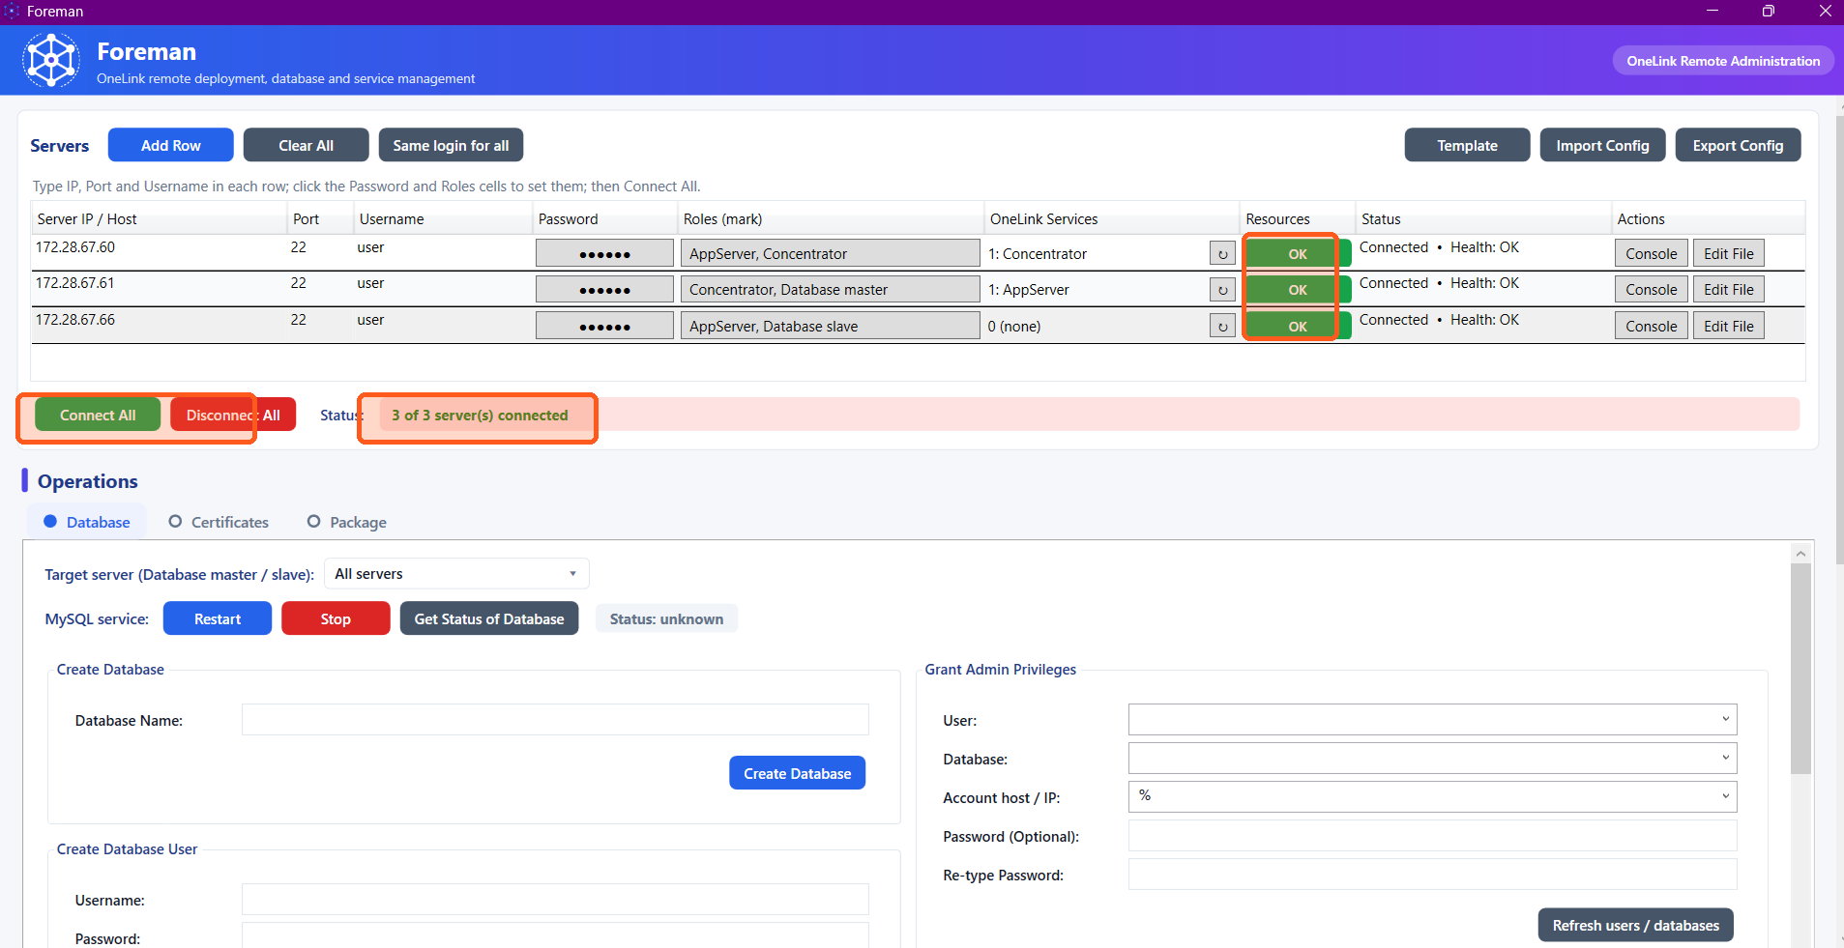
Overview
Foreman is a single-file PowerShell + WPF desktop application, compiled to one standalone .exe, that manages a fleet of One Link servers over SSH from one Windows GUI.
Replaces juggling PuTTY, WinSCP, and each server's own nmenu text-menu tool separately for every deployment and admin task.
Four operation tabs — Database, Certificates, Package, and a hidden Metrics tab — plus a built-in File Editor and SSH Console.
Everything needed is embedded (UI, default config, the SSH engine) — copy the .exe, run it, nothing else to install.

Slide 3
Application Purpose
Primary mission: give One Link admins one guided tool to connect to, configure, and maintain AppServer, Concentrator, Report Server, nConnect, and MySQL/MariaDB database servers — without hand-typed SSH commands.
Multi-server by design: every server row can be marked with one or more roles; most actions run across every selected, connected server at once, with a per-server success/failure summary.
Standalone deployment: the entire application — layout, logic, and the SSH library it depends on — is embedded in a single .exe. No PowerShell module install, no admin rights, no internet connection required on the target machine.
Built from real, measured usage: every click and field edit can be captured by the built-in Efficiency Recorder, which produced the time/steps comparison data later in this deck.

Slide 4
Server Inventory &
Connectivity

Slide 5
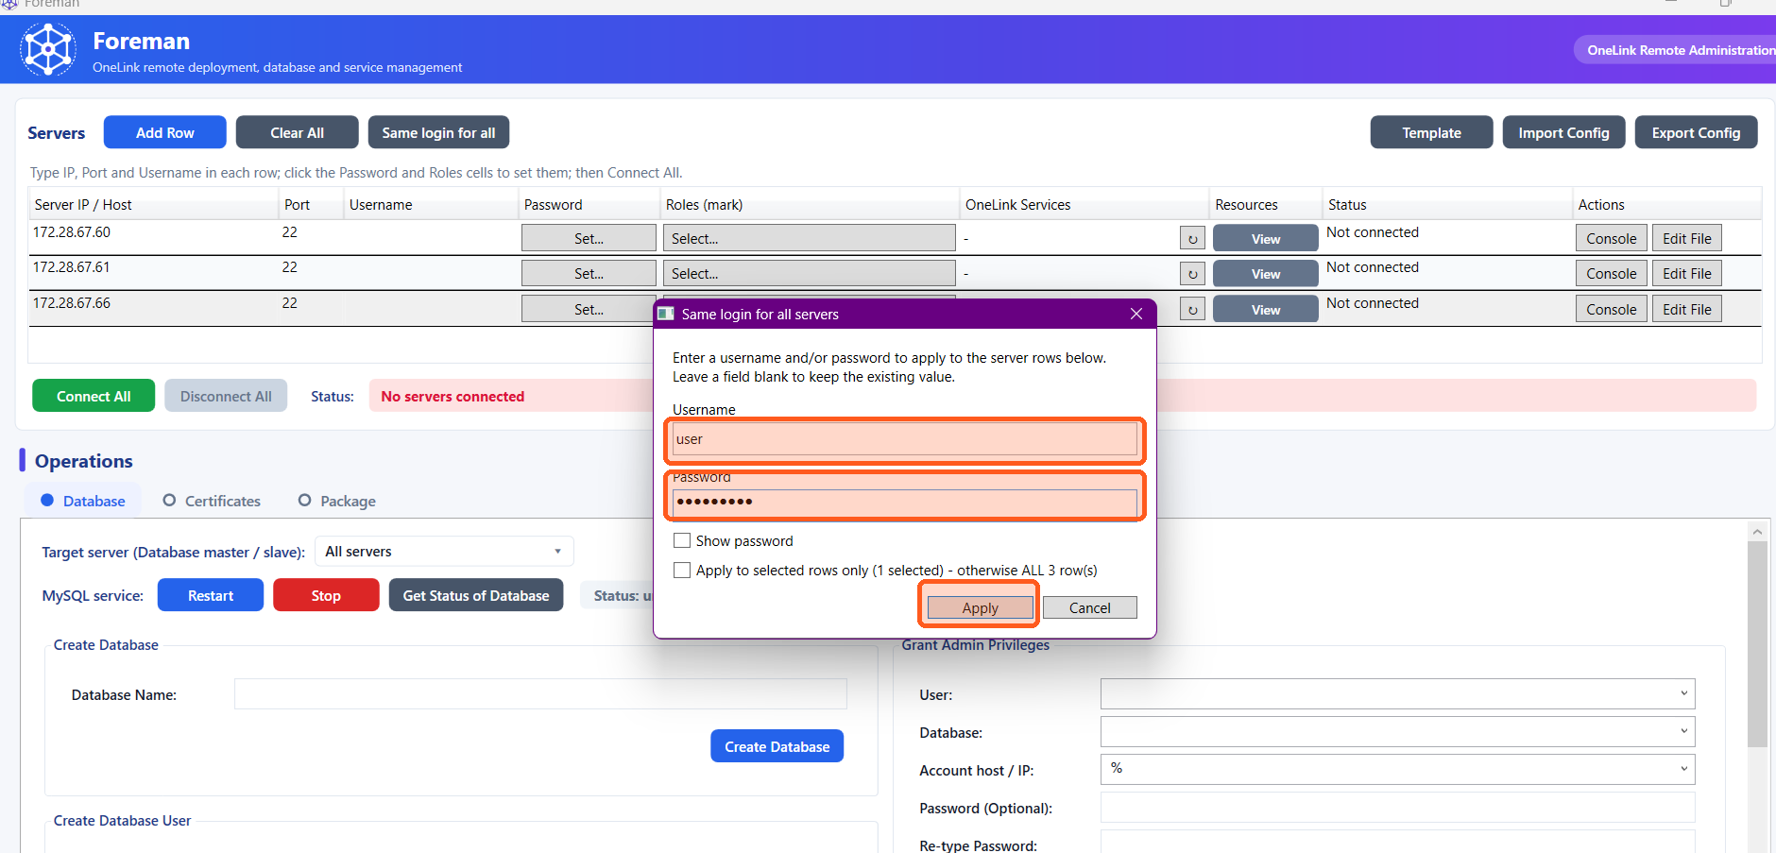
Same Login for All Servers
Bulk-set the SSH username and/or password across every server row in one dialog, instead of retyping credentials per row.
Leaving a field blank keeps that row's existing value.
‘Apply to selected rows only’ restricts the change to the rows currently selected in the grid; otherwise it applies to every row.

Slide 6
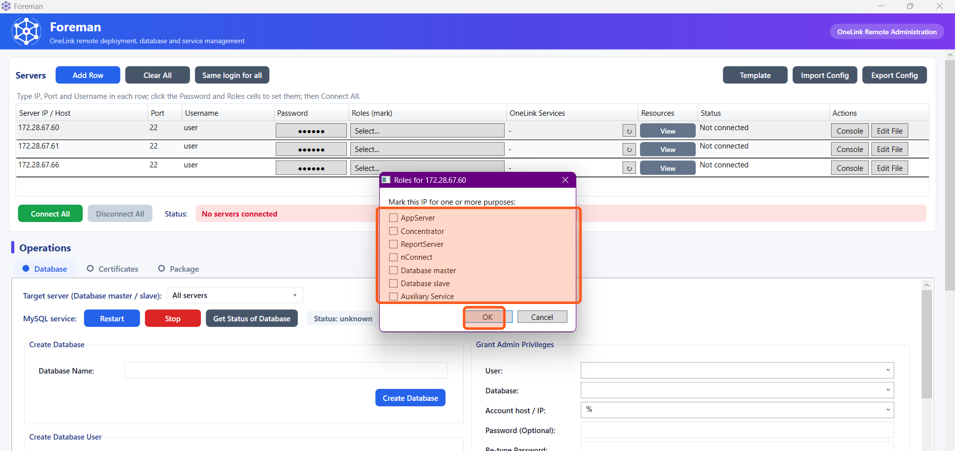
Marking Server Roles
Each server IP is marked with one or more purposes: AppServer, Concentrator, Report Server, nConnect, WebEvents, Database master/slave, or Auxiliary Service.
Role marks drive everything downstream — which services appear in the Service Installer, which package gets matched during deployment, and which servers are eligible as a Database target.
Auxiliary Service is for non-One Link software (nginx, PostgreSQL, a custom package) on the same box — its systemd units are auto-discovered rather than hardcoded.

Slide 7
Connect, Health & Status
Connect All opens SSH sessions to every server with an IP and credentials; a live status line tracks how many are connected.
Each row's disk and memory health is polled and shown as a coloured pill — green OK, amber CAUTION, red CRITICAL — refreshed on connect and on demand.
Passwordless sudo is bootstrapped automatically at connect time using the login credentials already entered, so later operations never prompt for a password.
A footer ‘Reset Tool’ button recovers from a stale/stuck SSH session (the tool sitting open a long time) by clearing every connection and any stuck job flag — without closing Foreman or losing the server list, settings, or package plan.

Slide 8
Core Operations
Walkthrough

Slide 9
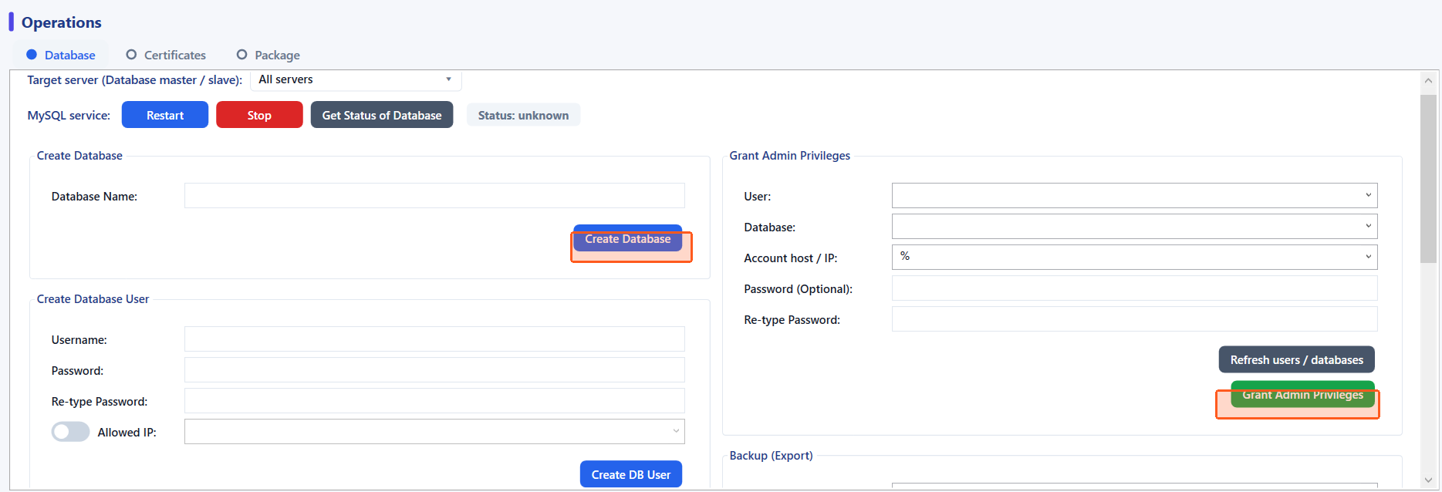
Database Tab — Create & Grant
Create Database and Create DB User check first whether the target already exists and report it plainly, instead of silently recreating or resetting a password.
Grant Admin Privileges creates the account if it doesn't exist (MySQL 8 requires this explicitly), then grants — the password field is optional, so a grant can be applied without touching an existing account's password.
‘Refresh users / databases’ populates every dropdown live from the target's real MySQL — root and MySQL's own internal accounts are filtered out for safety.

Slide 10
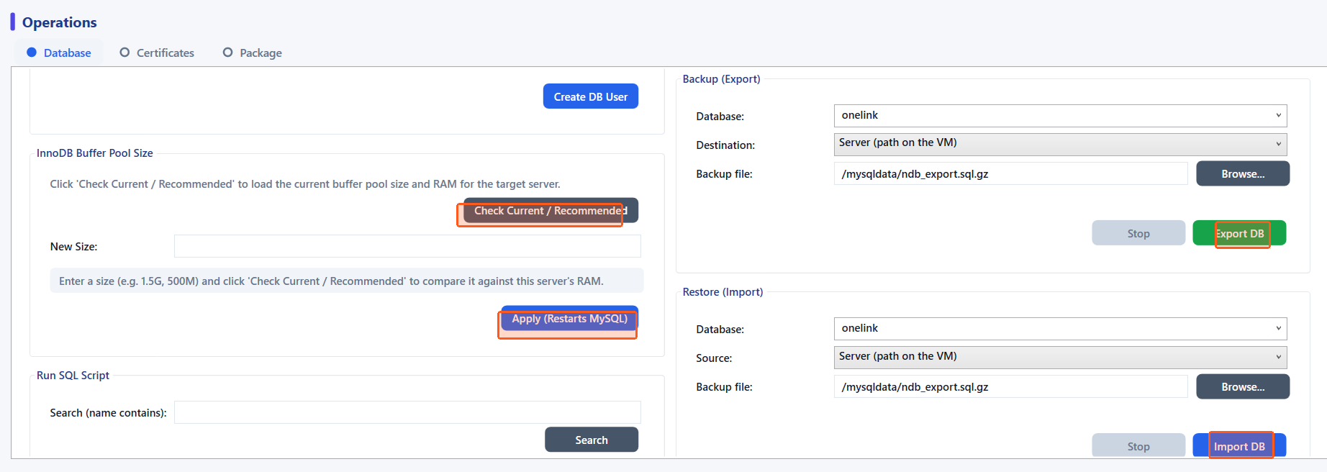
Database Tab — Tuning, Scripts & Backups
InnoDB Buffer Pool: reads the server's RAM, computes a safe maximum (75%), and applies the change with an automatic config backup and rollback if MySQL fails to restart.
Run SQL Script: searches the whole server for a matching .sql file by name and runs it in the background with a live progress window and plain-English error hints.
Backup (Export) / Restore (Import): to a path on the server, to this PC, to a network share, or directly between two VMs — all as background jobs with a Stop button.

Slide 11
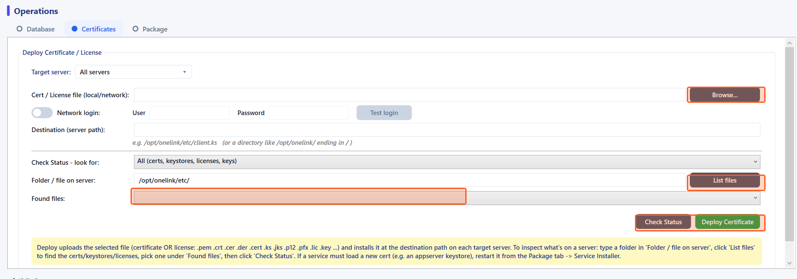
Certificates Tab
Deploy Certificate uploads a local or network certificate/keystore file and installs it to any destination path on the target server.
Certificate status is read by content, not file extension — a certificate, key, CSR, or keystore is correctly identified even when its name is misleading.
List files scans a folder on the server for matching certificate/key types so the exact filename doesn't need to be known in advance.
Before overwriting, Deploy can back up whatever file already exists at the destination — to this PC or to a folder on the server itself, your choice.

Slide 12
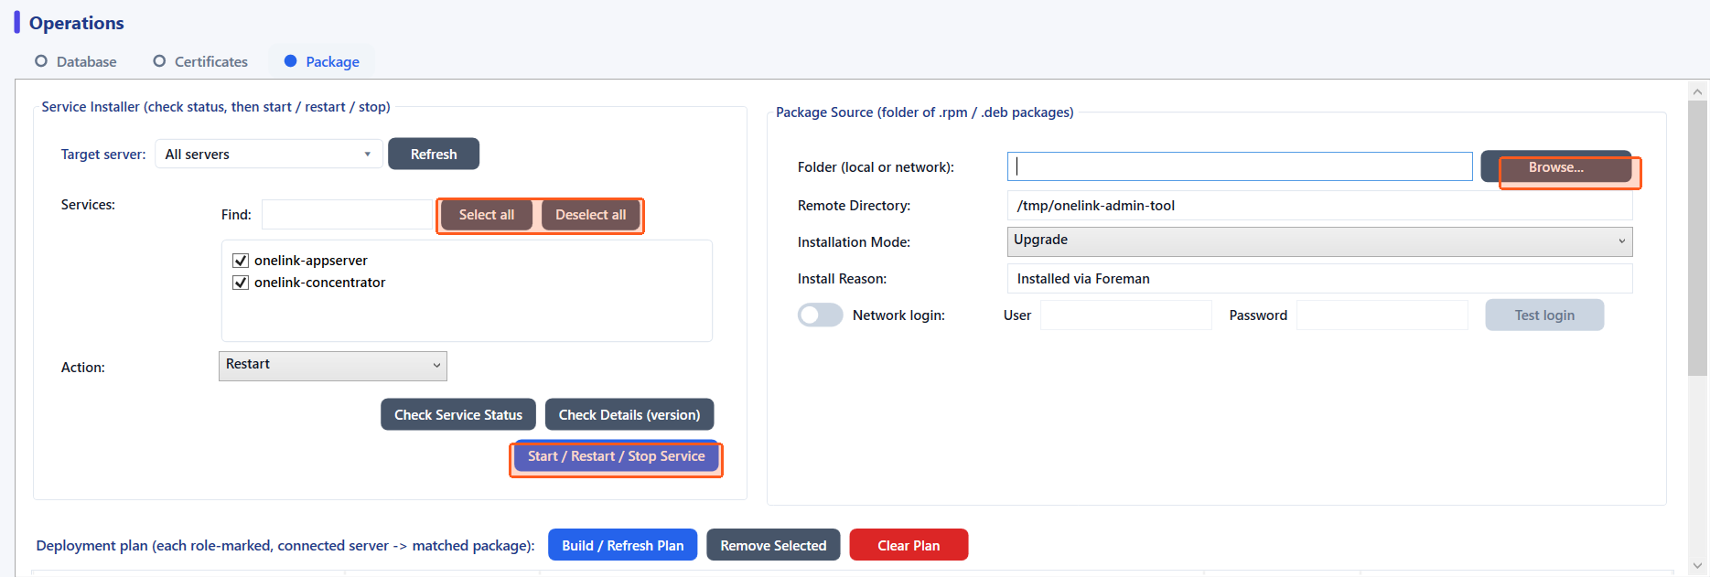
Package Tab — Service Installer
One checklist covers every service relevant to the selected servers' roles, with search and Select all / Deselect all.
Restart / Stop show a pre-check of which services are actually installed on each target before acting, so nothing runs against a server that doesn't have that service.
Check Details (version) reports installed package versions per server in one aligned report.

Slide 13
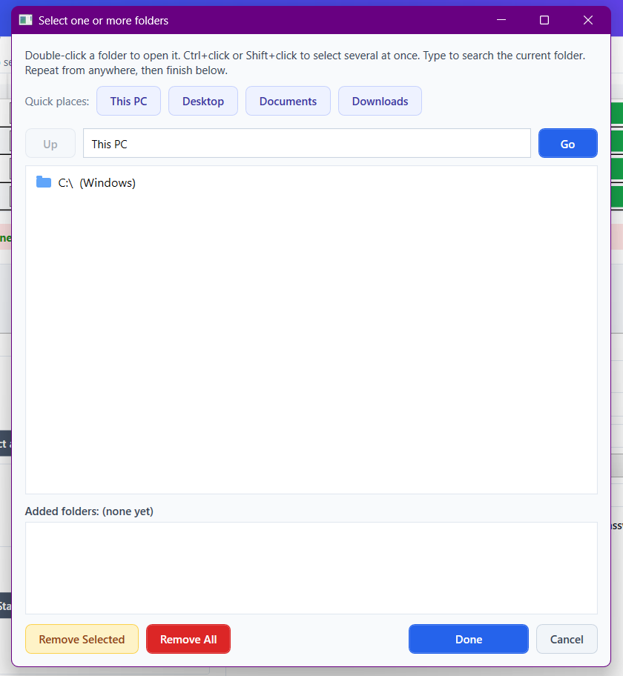
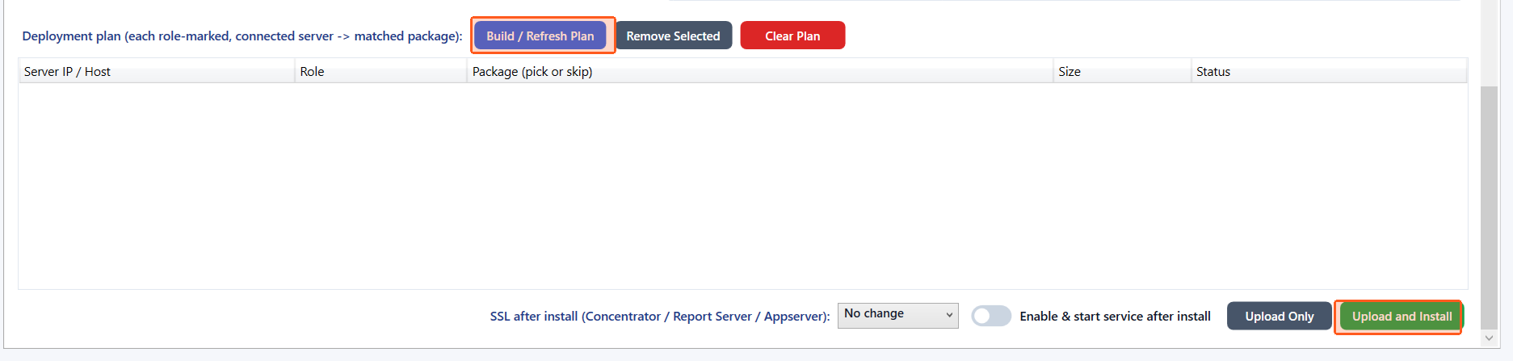
Package Tab — Deployment Plan & Install
Build / Refresh Plan matches every connected, role-marked server to the right package file automatically, by filename pattern AND the server's actual OS — folders are searched recursively, and a role with nothing built for that OS is left ‘No matching package’ instead of getting the wrong one.
Browse opens a real Explorer-style picker (starts at ‘This PC’): double-click to open a folder, Ctrl/Shift+click to multi-select several, type to live-search, and Quick places jump to Desktop/Documents/Downloads. One button adds picks and finishes — Remove Selected/Remove All fix a mistake before closing.
A downgrade guard compares installed vs. selected version and requires an explicit risk acknowledgement before installing a lower version.
Upload and Install verifies success against the server's own package database, not the installer's exit code — and can enable SSL and start the service immediately after.

Slide 14
Built-in Tools &
Diagnostics

Slide 15
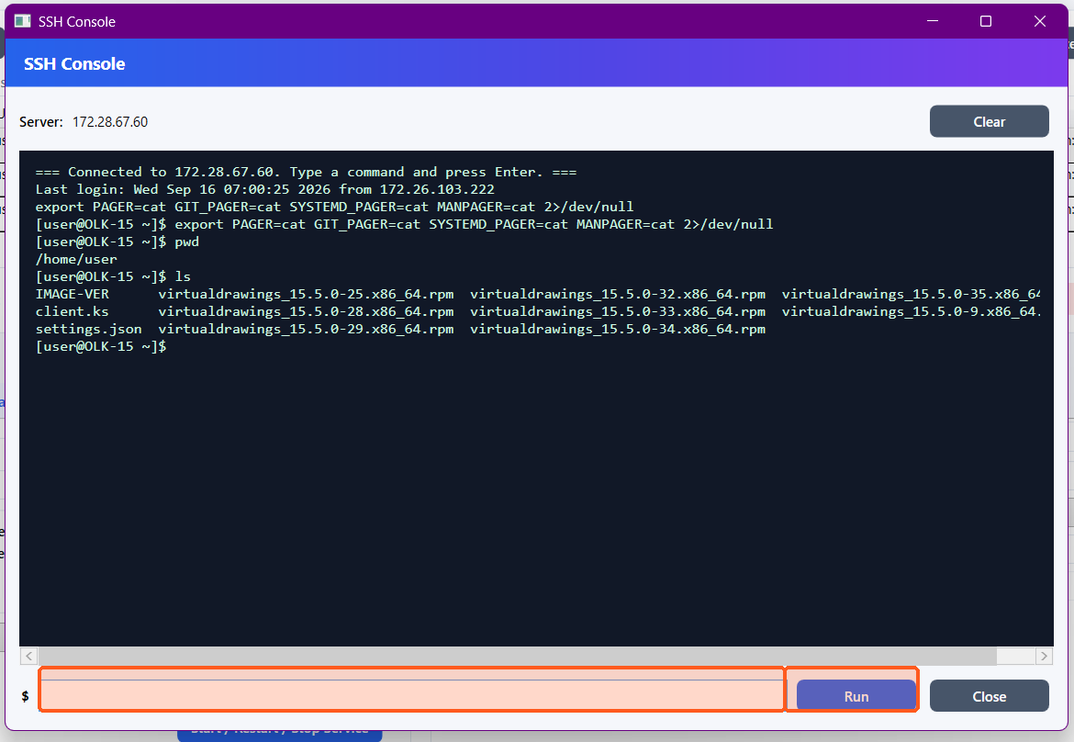
Built-in SSH Console
A live, persistent shell to a connected server — cd, environment variables, and sudo all carry over between commands, right inside Foreman.
Replaces opening a separate PuTTY session for one-off commands.
Full-screen interactive programs (vim, nano, top, less) are refused with a clear message, since this is a plain console, not a terminal emulator.

Slide 16
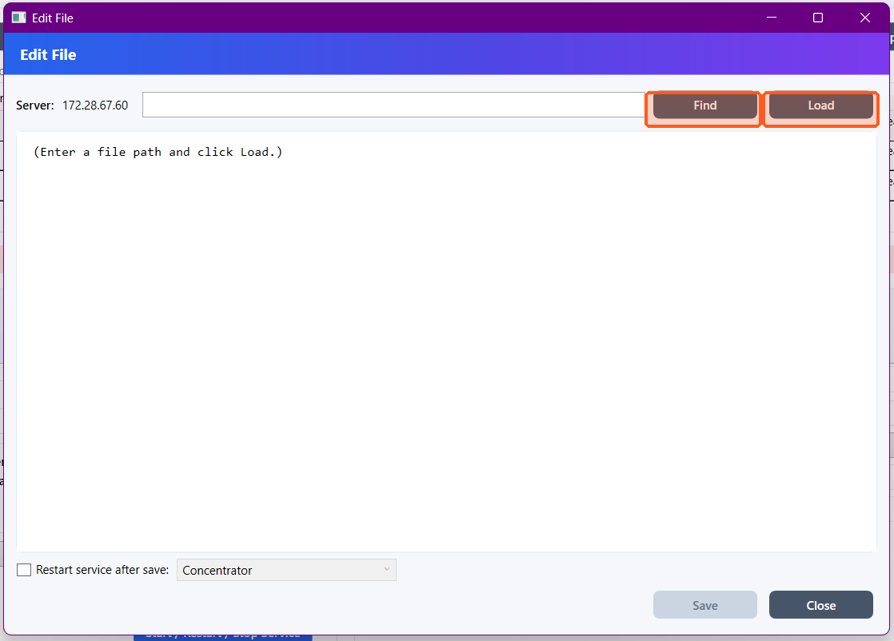
Built-in Remote File Editor
Find or type a file's path, load it, edit it, and save — without opening a separate SSH session and using nano or vi on the server.
Save takes a timestamped backup first and preserves the file's owner and permission bits.
Can optionally restart a service immediately after saving, e.g. after editing a config file.

Slide 17
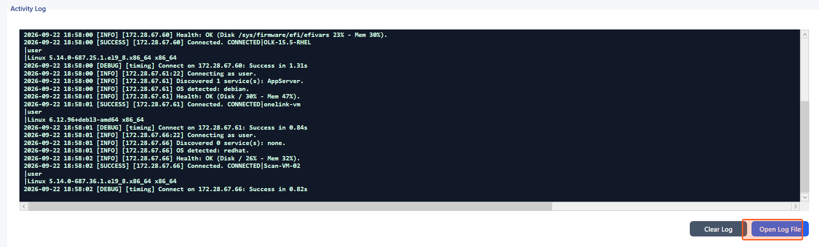
Activity Log & Connection Diagnostics
Every action — connect, health check, service discovery, OS detection — is logged with a timestamp and outcome, visible live in the app.
Open Log File jumps straight to the full log on disk for deeper troubleshooting.
Sample below: three servers connecting, discovering services, detecting OS, and reporting health, all in under two seconds each.

Slide 18
Efficiency Recorder
& Reporting

Slide 19
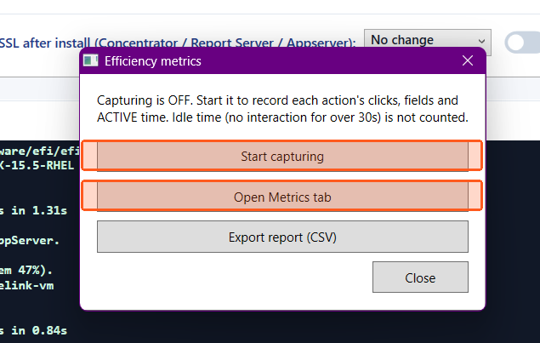

Efficiency Recorder
An opt-in recorder (footer button, top right of the app) captures clicks, fields edited, and ACTIVE time for every completed action — idle time (30s+ with no interaction) is excluded.
Start capturing, jump to the Metrics tab, or export the captured report as a CSV, all from one small panel.
This is the real, measured data behind the time/steps comparison on the next slides — not an estimate.

Slide 20
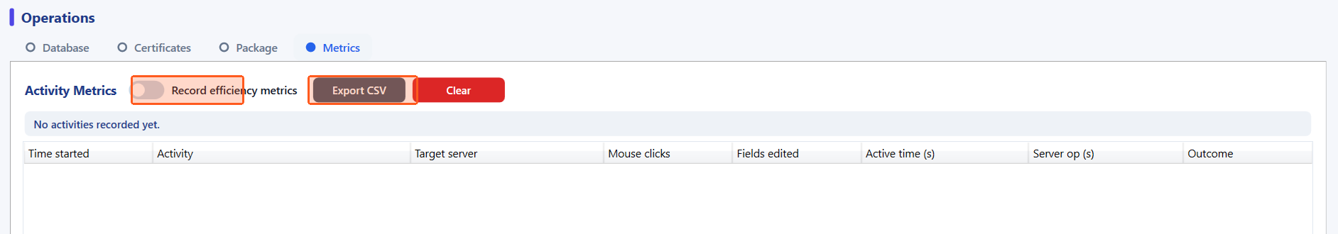
Activity Metrics Tab
Every captured activity appears as a row: time started, what it was, target server, clicks, fields edited, active time, and server-side operation time.
Export CSV produces the same data used for the manual-vs-tool comparison in this deck.

Slide 21
Measured Impact — Full Deployment Lifecycle
~35 min
Time saved per deployment
(04:15:28 → 03:40:55)
~12%
Time reduction
(vs. 10% OKR target)
84
Fewer manual steps
(435 → 351)
~16%
Steps reduction
(vs. 10% OKR target)
Figures cover the FULL deployment lifecycle — including OS/network provisioning and web-UI licensing work Foreman doesn't touch — measured against a real, keystroke-verified manual runbook and Foreman's own Efficiency Recorder. Figures are rounded down for a conservative estimate; both measures exceed the 10% OKR target set for this initiative.

Slide 22
Operator Checklist
Confirm the SSH account for each target server has (or can be granted) sudo rights — Foreman bootstraps passwordless sudo automatically on first connect using the login credentials.
Confirm network access from this Windows machine to every target server's SSH port.
Mark each server's role(s) before connecting — role marks drive service discovery, package matching, and which servers are eligible Database targets.
For Package tab work: have the .rpm / .deb files (or a network share) ready, and know the intended install reason text.
For Certificates: know the exact destination path expected on each server (e.g. /opt/onelink/etc/client.ks).
Optional: turn on the Efficiency Recorder (footer button) before starting a session if you want a timed record of what was done.

Slide 23
Where to Find More
Foreman User Guide — click-by-click usage instructions for every tab and feature.
Foreman Overview Document — architecture and every feature described in detail, no code.
Foreman Code Study Guide — PowerShell fundamentals and line-by-line teaching, for anyone new to the language.
Foreman Code Walkthrough — real code, quoted directly from source with line numbers, for maintainers.
Source: cxs-devops-OnelinkAdministratorTool (branch dev/Foreman) — structured under src\, see src\README.md.

Slide 24
Thank You

